Slide 1
Quasi-Biennial Oscillation Influence
On The Madden-Julian Oscillation
Presenters Name:
Wes Lee Johnson
Mentor’s Name:
Senior Research Scientist Lon Hood of The Lunar and Planetary Laboratory at the University of Arizona

Slide 2
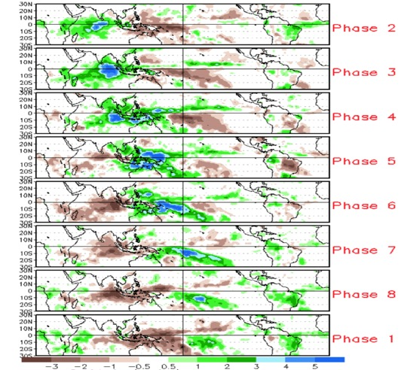
The Madden Julian Oscillation (MJO) is a subseasonal (30 to 90-day) variation of tropical convection and precipitation that produces effects on weather outside of the tropics (similar to El Nino but on a shorter time scale).
The Madden Julian Oscillation (MJO) both suppresses and increases precipitation.
Credit: Jon Gottschalck

Slide 3
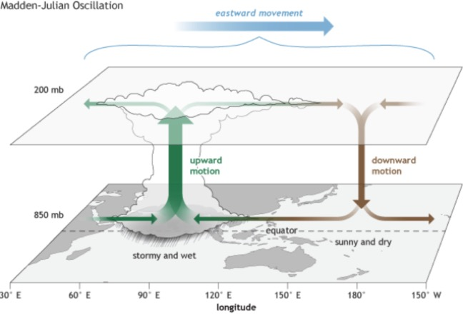
MJO
Credit: Cici Zhang

Slide 4
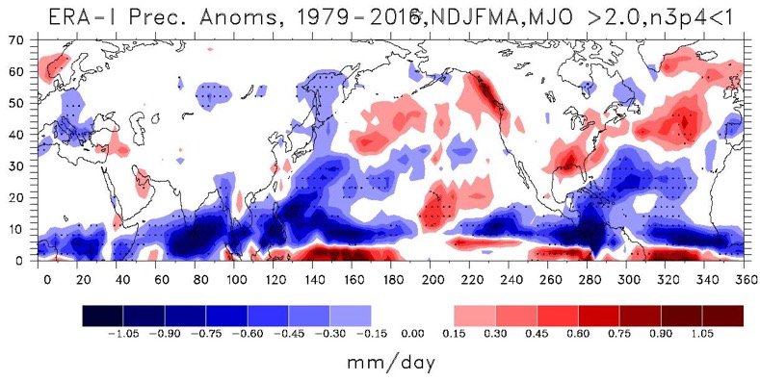
This plot shows the difference between the surface precipitation during strong MJO events over the November to April season and the average precipitation.

Slide 5
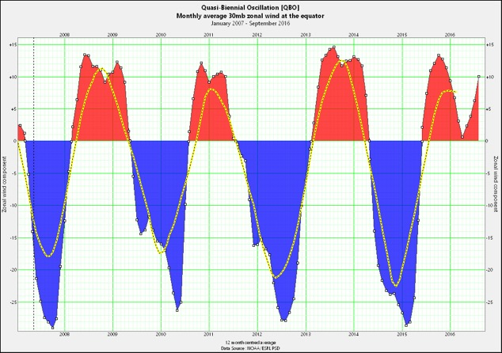
The Quasi-Biennial Oscillation (QBO) is a stratospheric circulation pattern with an east and west phase.
Red: West Phase
Blue: East Phase
Credit: Xmetman

Slide 6
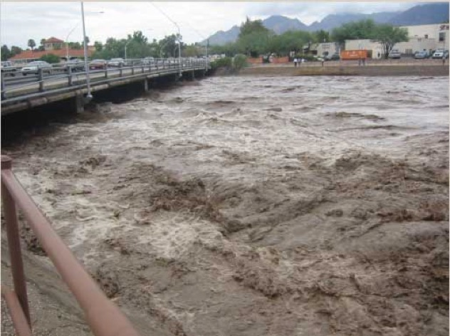
Understanding how the stratospheric QBO affects the MJO could lead to better extended range weather predictions.
The Rillito River in Tucson during flood stage.
Credit: Theodora Petanidou.

Slide 7
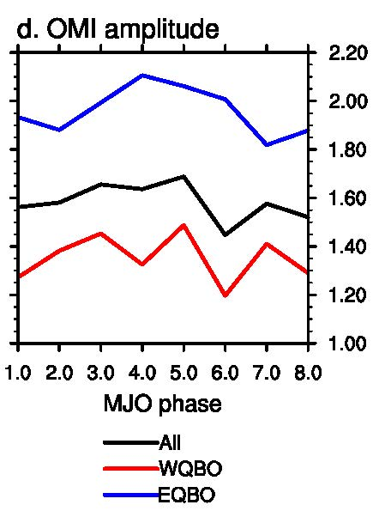
Motivation:
There is statistical evidence that the easterly blowing phase increases the MJO amplitude while the westerly phase decreases it (Yoo and Son, GRL, 2016).
Credit Yoo, Changhyun and Son, Seok‐Woo

Slide 8
Why would the QBO interact with the MJO?
The MJO is an eastward propagating tropical weather disturbance with convection sometimes reaching up into the lower stratosphere.
The QBO lower stratospheric wind oscillation affects temperature in the tropopause region, which can affect the efficiency of convection in the troposphere.

Slide 9
Objective:
Explore the relationship between the Madden Julian Oscillation (MJO) and Quasi-Biennial Oscillation (QBO). Specifically, investigate how the QBO can influence surface precipitation through its effect on the MJO.

Slide 10
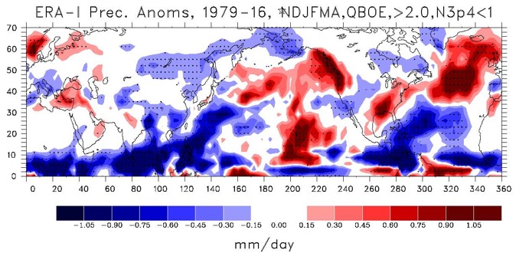
This plot shows the difference between the surface precipitation during the QBO East phase and the average precipitation (anomaly).
Calculated from ERA-Interim Reanalysis meteorological data.
Note: Periods of strong ENSO events are excluded and only days when the MJO is active are considered.

Slide 11
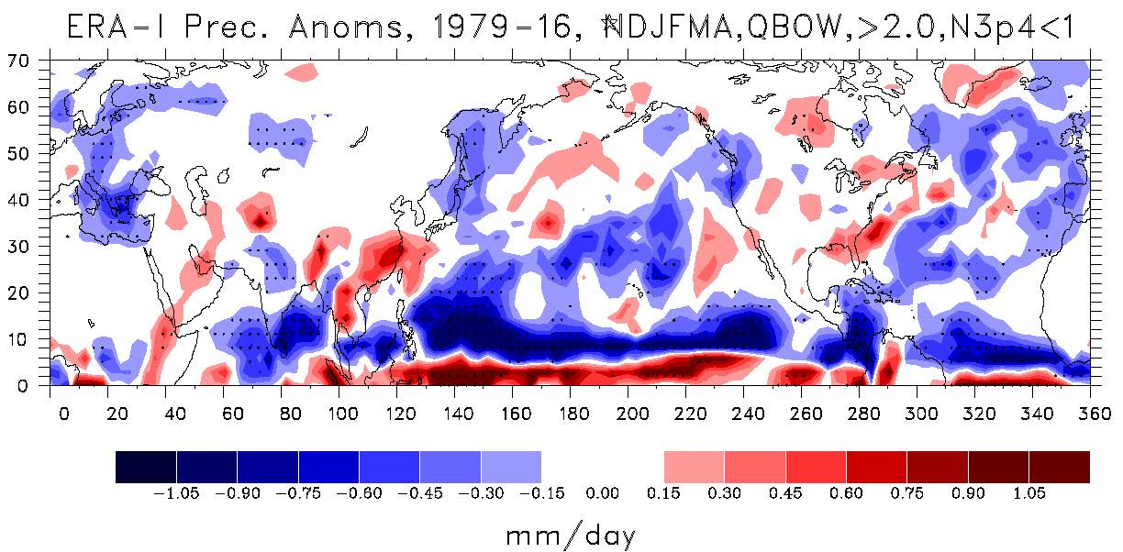
This plot shows the difference between the surface precipitation during the QBO West phase and the average precipitation (anomaly).
Calculated from ERA-Interim Reanalysis meteorological data.
Note: Periods of strong ENSO events are excluded and only days when the MJO is active are considered.

Slide 12

This plot shows the difference between the surface precipitation during strong MJO events over the November to April season and the average precipitation.

Slide 13
Conclusions
From the graphs above we see that during the QBOE phase, the surface precipitation increases in regions that are influenced by the MJO relative to that during the QBOW phase. This is consistent with the hypothesis that the increased MJO amplitude during QBOE can affect surface precipitation conditions.
Knowing this, we can see that the stratospheric QBO can potentially impact surface weather conditions.
This could lead to improvements in extended range (weeks to months) weather forecasting.

Slide 14
Acknowledgements
Thanks to the Arizona Space Grant Consortium and the NSF Climate and Large-Scale Dynamics Program for funding.
Thanks to my mentor Lon Hood, who has helped me greatly.
Thanks to my peer Malori Redman.
And all the Space Grant Consortium Organizers.

Slide 16
Measurements
We use the European Reanalysis data (ERA Interim) data.
This data are created in a process called data assimilation.
Observational data from satellites, weather balloons, and weather stations are fed into global weather models.
Their predictions are compared with actual data and the model’s predictions become better over time.
The ERA reanalysis data contains temperature and precipitation data across the whole globe that span back 39 years (among many other variables).

Slide 17
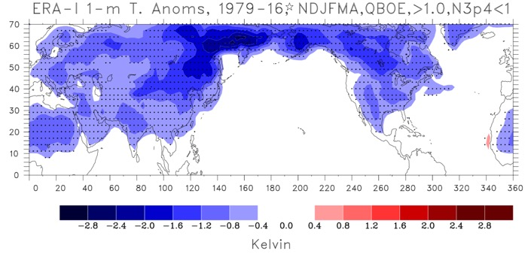
This plot shows the difference between the surface temperature during the QBO East phase and the average temperature (anomaly).
Note: Periods of strong ENSO events are excluded and only days when the MJO is active are considered.

Slide 18
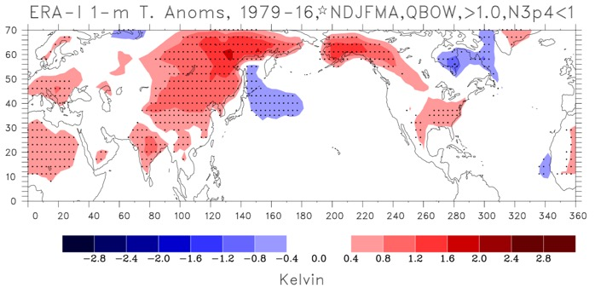
This plot shows the difference between the surface air temperature during the QBO West phase and the average temperature (climatology).
Note: Periods of strong ENSO events are excluded and only days when the MJO is active are considered.

Slide 19
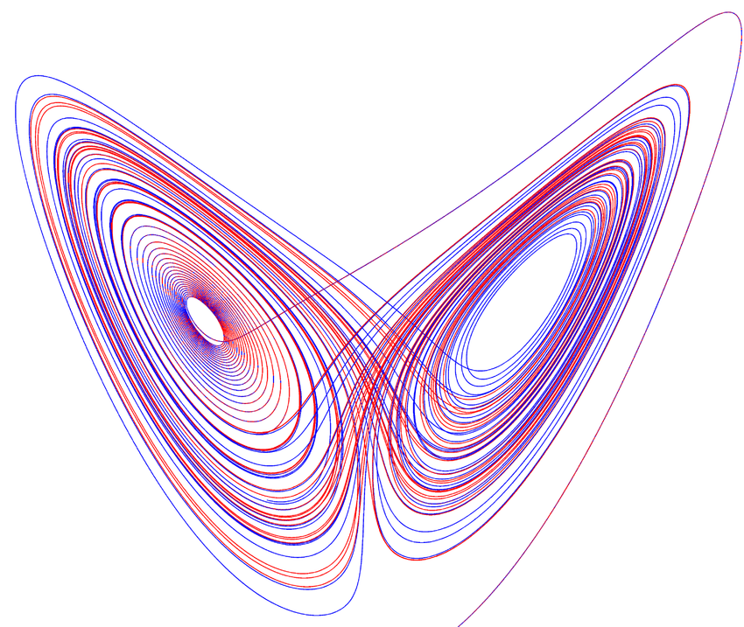
Credit: Gustavo Moreira, Carlos & Pacifico, Maria & Romaña, Sergio.

